Slide 1
CSE 464 : Software Quality Assurance and Testing
Testing Object Oriented Applications Janaka Balasooriya

Slide 2
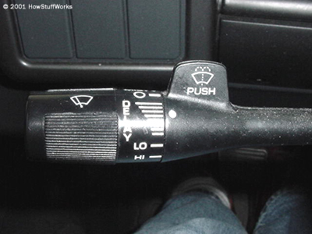
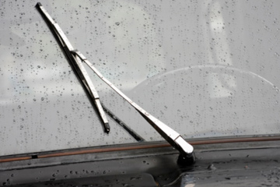
Windshield Wiper Example
auto.howstuffworks.com

Slide 3
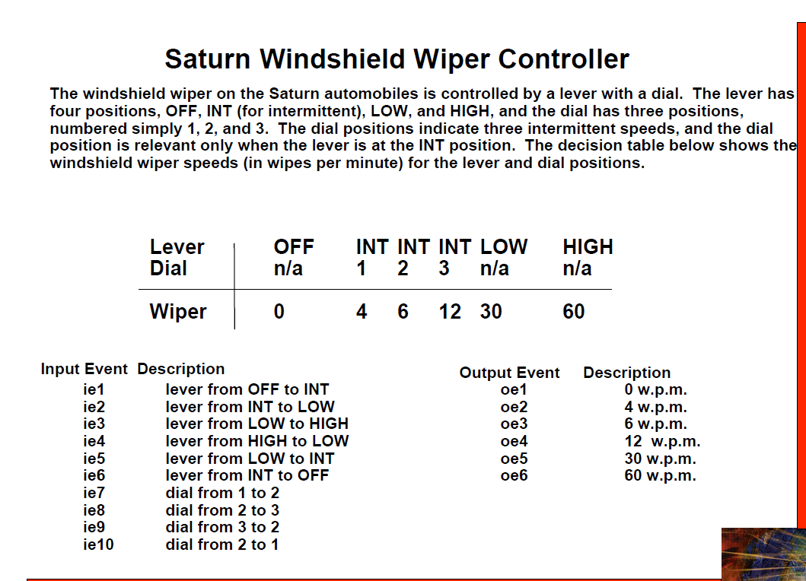

Slide 4
Testing the Windshield Wiper Application
Uisng JUnit
JUnit test cases that test get-set methods
JUnit test cases based on its usage – use case based
JUnit test cases based on state chart

Slide 5
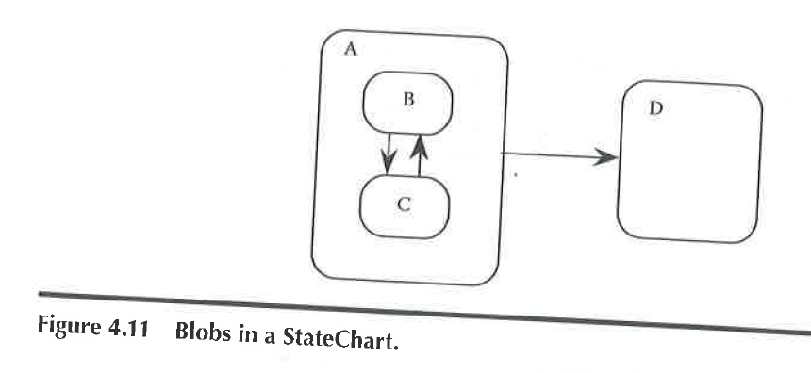
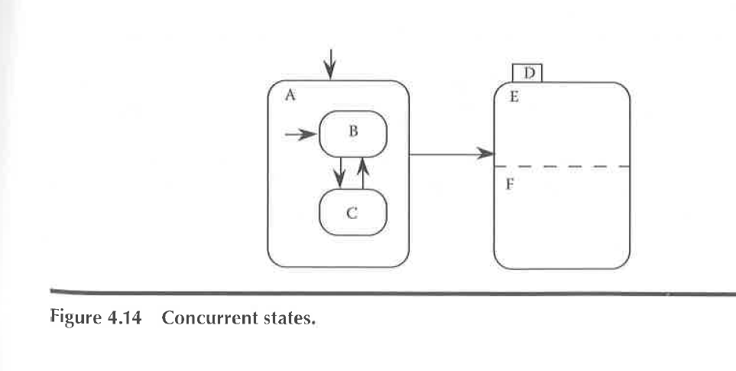
StateChart Based Testing
StateChart is a techniques that provides visual representation of states of objects, transitions, and change of states through transitions.
StateCharts can be used where the current action of an objects depends on previous actions.
State chart is a collection of “blobs” that represent state and arrows that represent transitions.
A blob can contain another blob
Also StateCharts can be used to represent concurrent states of more than one object

Slide 6
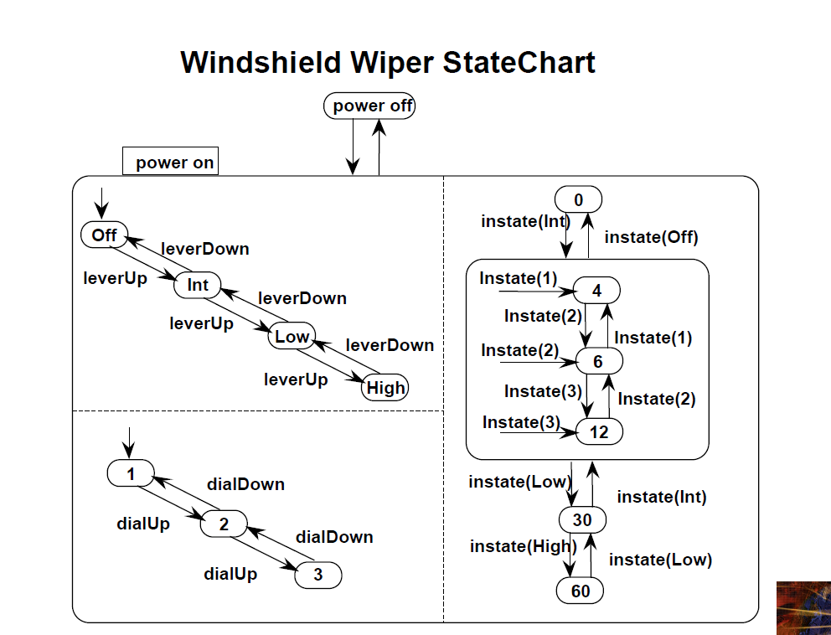

Slide 7
State-Chart Based test cases - Demo

